Slide 1
Real-time Sales Update
Building the Data Pipeline Project
Team 6:
Jayadev Vallath
Maria Mendoza
Alexander Mendoza

Slide 2
Use Case
The use case is focused on reporting which paint sales representatives have reached their gallon goal for the day which would qualify them for certain incentives and bonuses.
This scenario is critical, especially on the last day of the month and a real-time reporting of their progress is crucial to help their territory directors determine who to call in case they need help moving products
In this low-latency scenario, we will be using Postgres as the database to house all the necessary information and we will use Kafka as our messaging tool.
The output would highlight which sales reps have already attained their goal

Slide 3
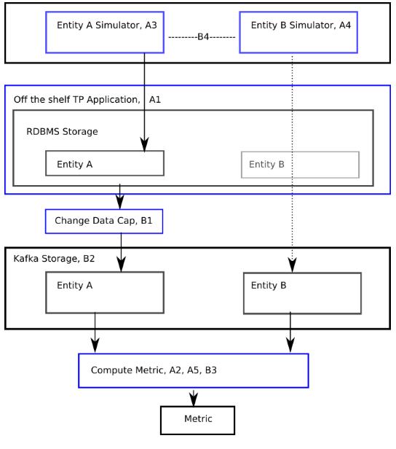
High Level Architecture
Entity A: Transaction simulator
Entity B: Sales Gallon Plan(?)
Metric: %Goal Attainment and Total Gallons per Sales Rep/Territory

Slide 4
Database Design Details
Sales Representative
Sales Rep Id | Sales Rep Name | Sales Rep Territory | Daily Gallon Plan
1-001 | John Smith | NE | 500
1-002 | Linda Errico | SE | 1000
1-003 | Ed Snith | NYC | 3000
1-004 | Dennis Brunzell | GL | 2000
1-005 | Carl Kowaski | WC | 1000
1-006 | Jung Lim | NYC | 1000
1-007 | Andy Jerkin | NE | 500
1-008 | Carla Pollak | WC | 2000
1-009 | Samson Smith | TX | 4000
1-010 | Lori Ann Curt | SE | 3000
Territory
Territory ID | Territory Name
NE | North East
SE | South East
NYC | New York Metro
GL | Great Lakes
WC | West Coast
TX | Texas
Product
Product Id | Gallons
N001 | 5
A001 | 5
C005 | 0.5
M004 | 0.25
N005 | 0.5
Transaction
Order Date | Order Time | Sales Rep Id | Product Id | Units Sold
May 31 2016 | 8:00 AM | 1-001 | N001 | 16
May 31 2016 | 8:00 AM | 1-001 | A001 | 10
May 31 2016 | 8:00 AM | 1-001 | M004 | 15
May 31 2016 | 8:00 AM | 1-001 | N005 | 18
May 31 2016 | 9:15 AM | 1-010 | C005 | 20
The output should send a message if a sales rep has already attained his daily. Ideally it should also send a message which sales reps are below 50% of their goal from mid-day onwards. Alternatively, see the dashboard on the next page
Progress Report Output
Order Date | Sales Rep Id | Sales Rep Name | Sales Rep Territory | Monthly Gallon Plan | Actual Sales | % Plan Attainment

Slide 5
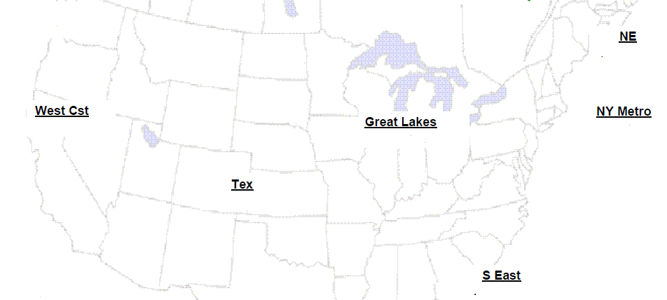
Dashboard Proposal
Sales Rules:
When a territory hits its goal – the area (or maybe a circle, like above) would show green
If a territory is > 50% of its goal – the area would show yellow
If a territory is < 50% of its goal – the area would show red
Trend Rules:
If the sales is trending up – arrow beside circle shows up
If the sales is trending down – arrow goes down
If the sales is trending flat – show a horizontal arrow

Slide 6
Transaction Generator Details

Slide 7
Kafka Messaging Details

Slide 8
Output

Slide 9
Summary

